Slide 1


Happy Insurance
Analytics Team (TCBDA16):
Alina Greenberg & Shaul Tzur
Date: 01/09/022

Slide 2


Definitions
The sales quantity with negative values throughout the analyzed period are assumed to be a way to provide a refund or discount to clients, decided by management, and set in the form of credit.
For the purpose of the analyses, it was used the original geographical definition (GEO) without consideration for grouping countries accounting to income or similar culture.
The data is shown in absolute terms and lacks a per capita basis and makes it not possible to properly compare countries with different population sizes, therefore only regional comparison seemed adequate.

Slide 3
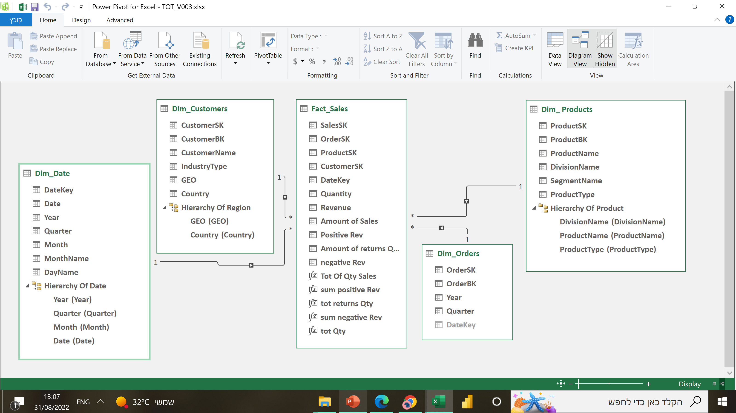
Star Scheme

Slide 4





Project Timeline Template
4
STAGE 01
Obtaining the relevant data from one or multiple sources. In this case, CSV file and SQL DB.
Build ETL process using M Language on Power Query, transformation databases (DIM & Fact Table) and building a Star Schema.
STAGE 03
Creation of measures on Power Pivot & Bi, adapting table names and finalizing tabular model to easily attend business necessities to users.
STAGE 02
STAGE 04
STAGE 05
Defining which data we wish to present to users, create measures (Dax Language) and start the visual creation.
Final details on reports and visuals on both Power Bi and Power Pivot.

Slide 5
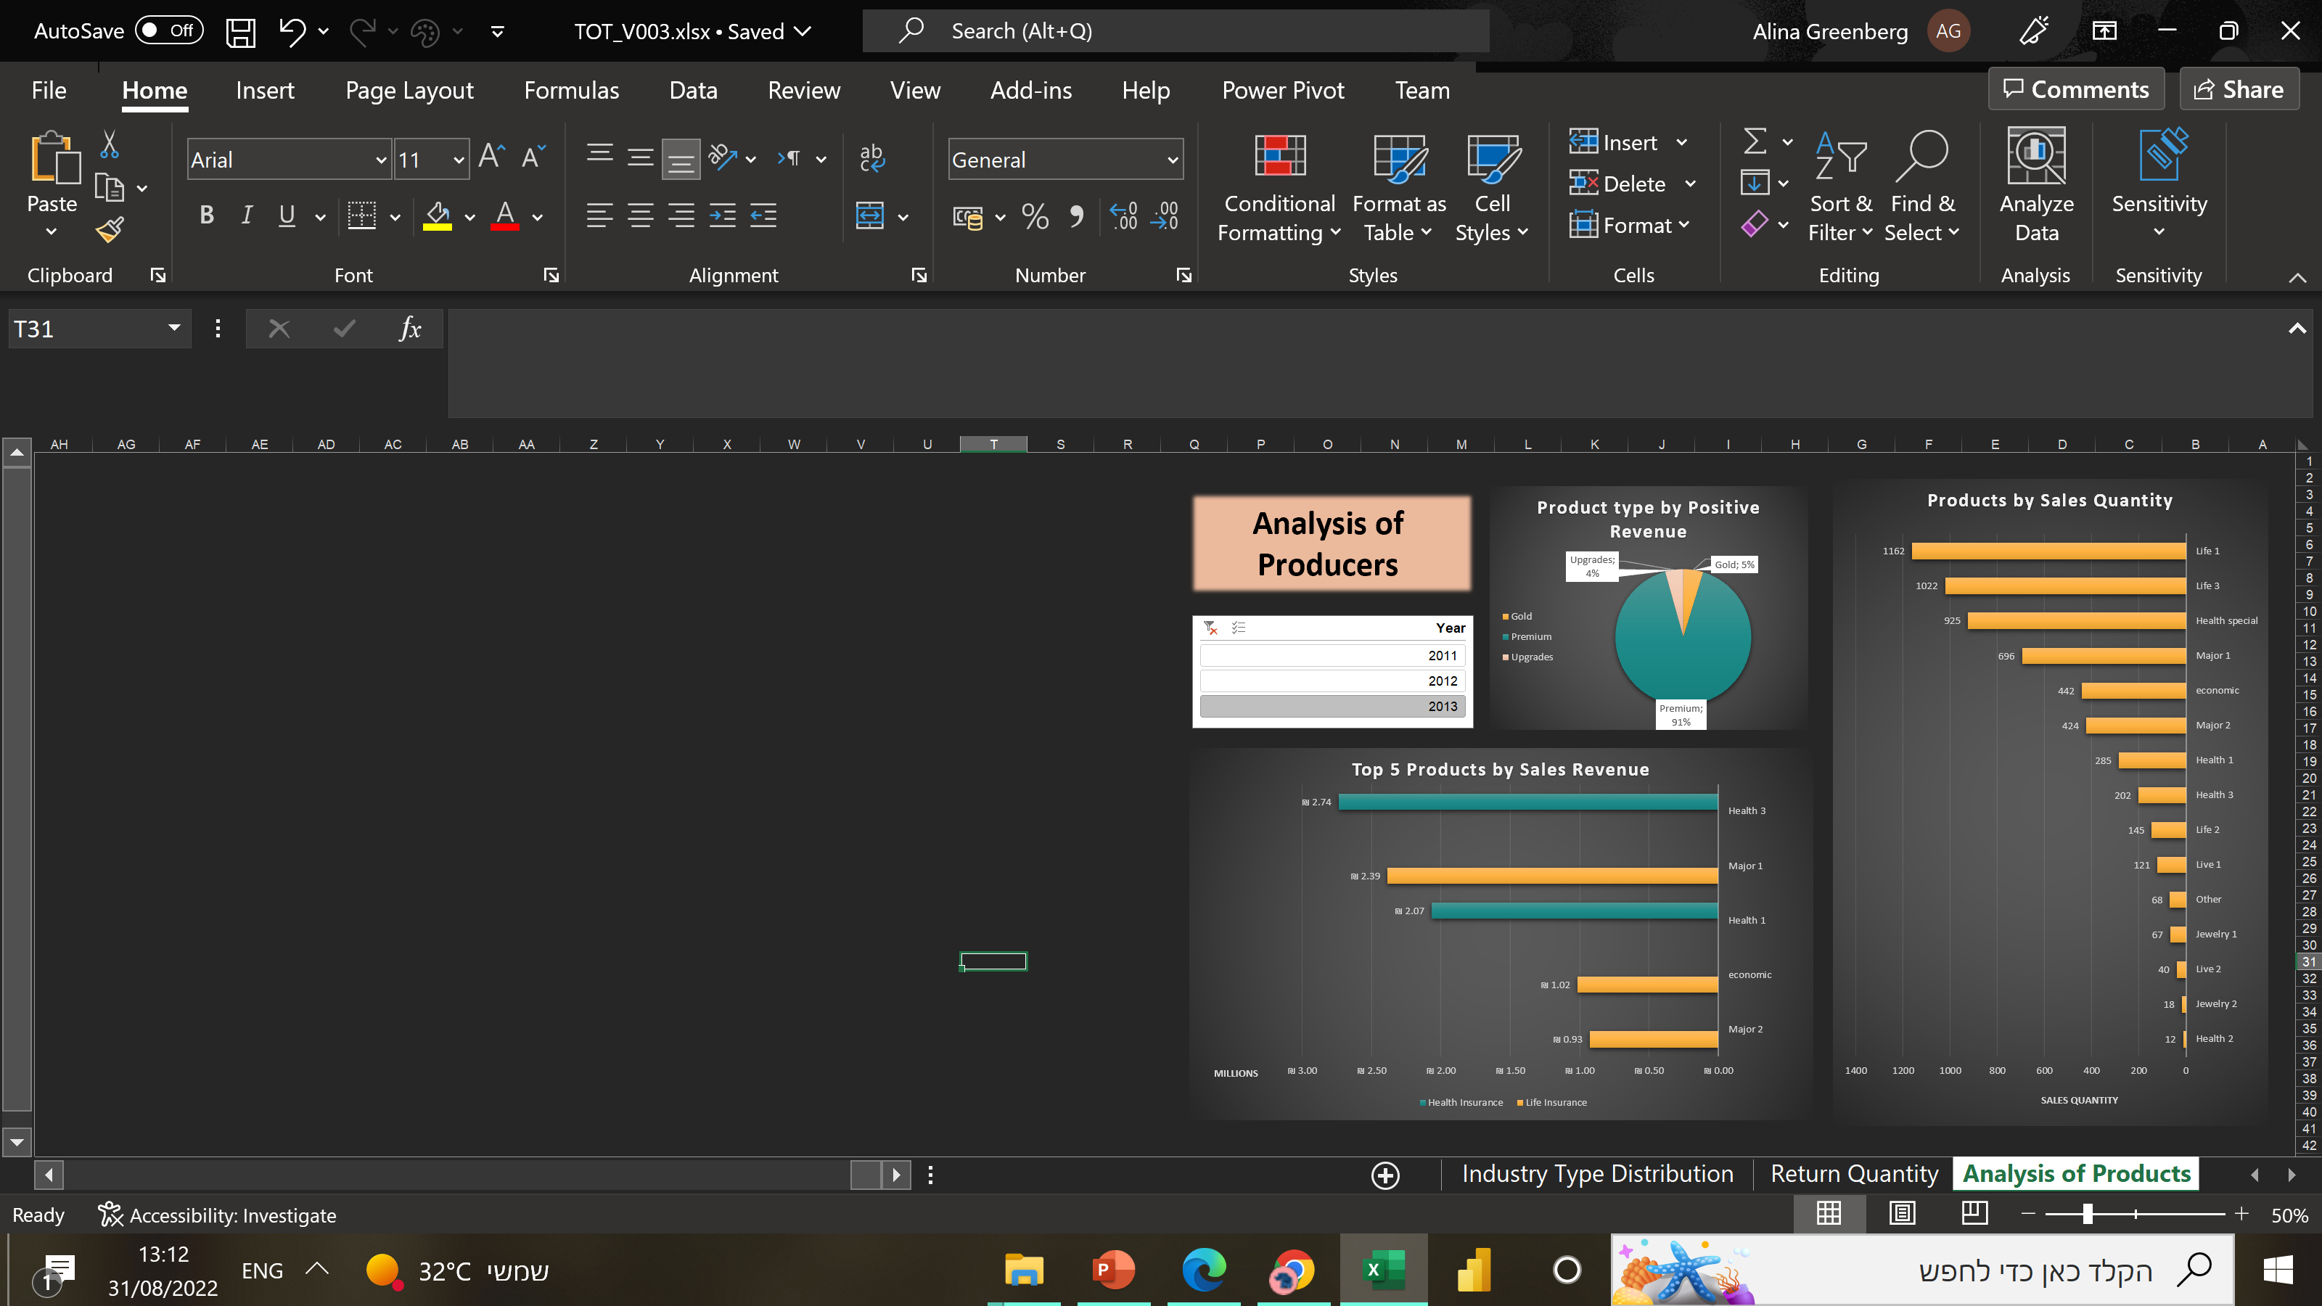
5

Slide 6
Insights for Product Analysis:
Health 1 has been losing its participation size throughout the years moving from a leading position of 31% in 2011 to a no longer leading position of 18% in 2013. In the opposite direction, Heath 3 has been growing in participation size growing from 11% to an impressive 24%.
Product Type is dominated by the Premium segment with almost no variation throughout the years and with very little variation throughout the regions.
6

Slide 7
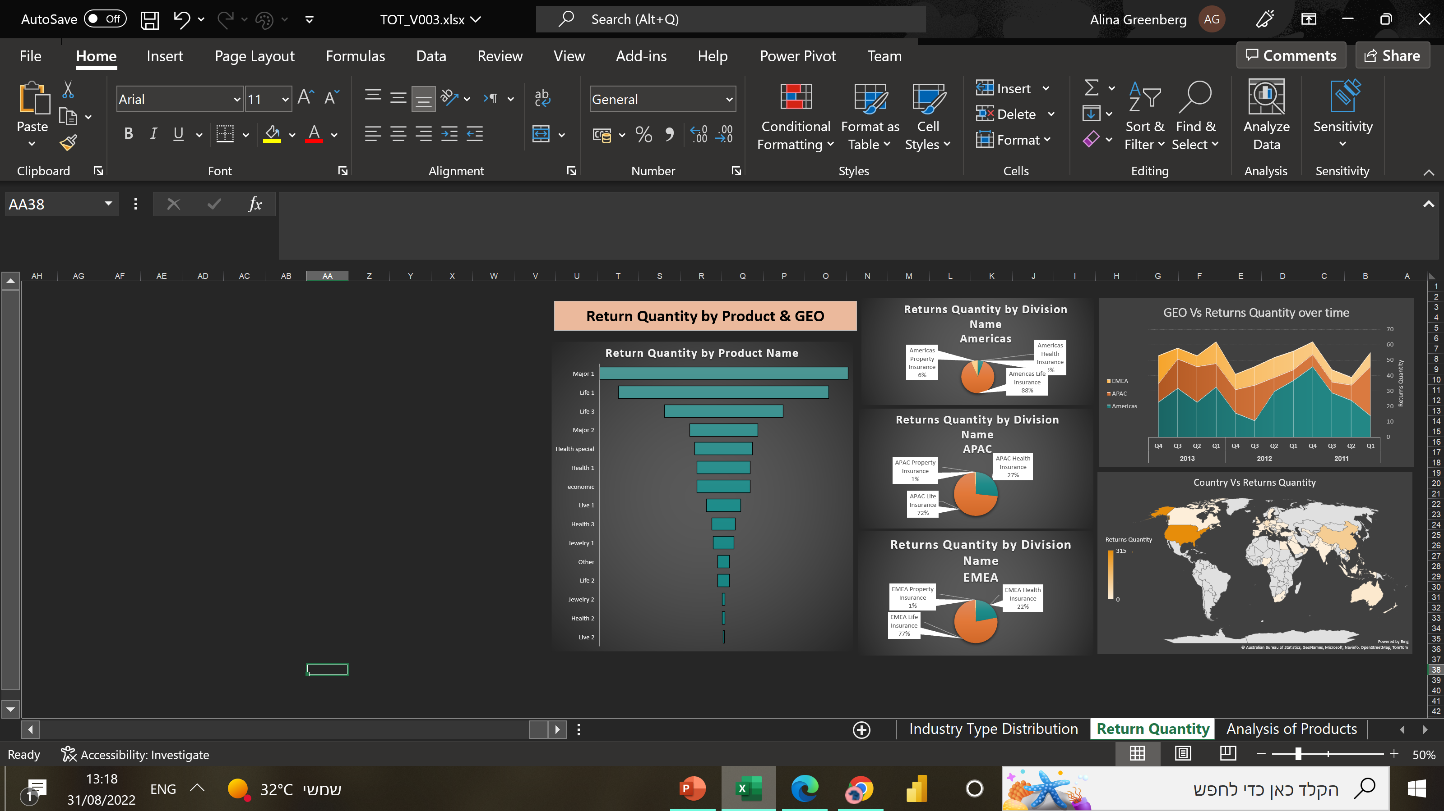
7

Slide 8
Observations for Return Quantity:
When broken down by region, the return quantity varies from 1% to 5% being the overall return at about 3% of the total amount of ordered quantities. The first product name on the return list is Major 1 which is quite reasonable since this product name holds a very large percentage on the revenue composition. The surprising factor is Life 1 & Life 3, which both hold a very miniscule sales participation having a massive return quantity.
8

Slide 9
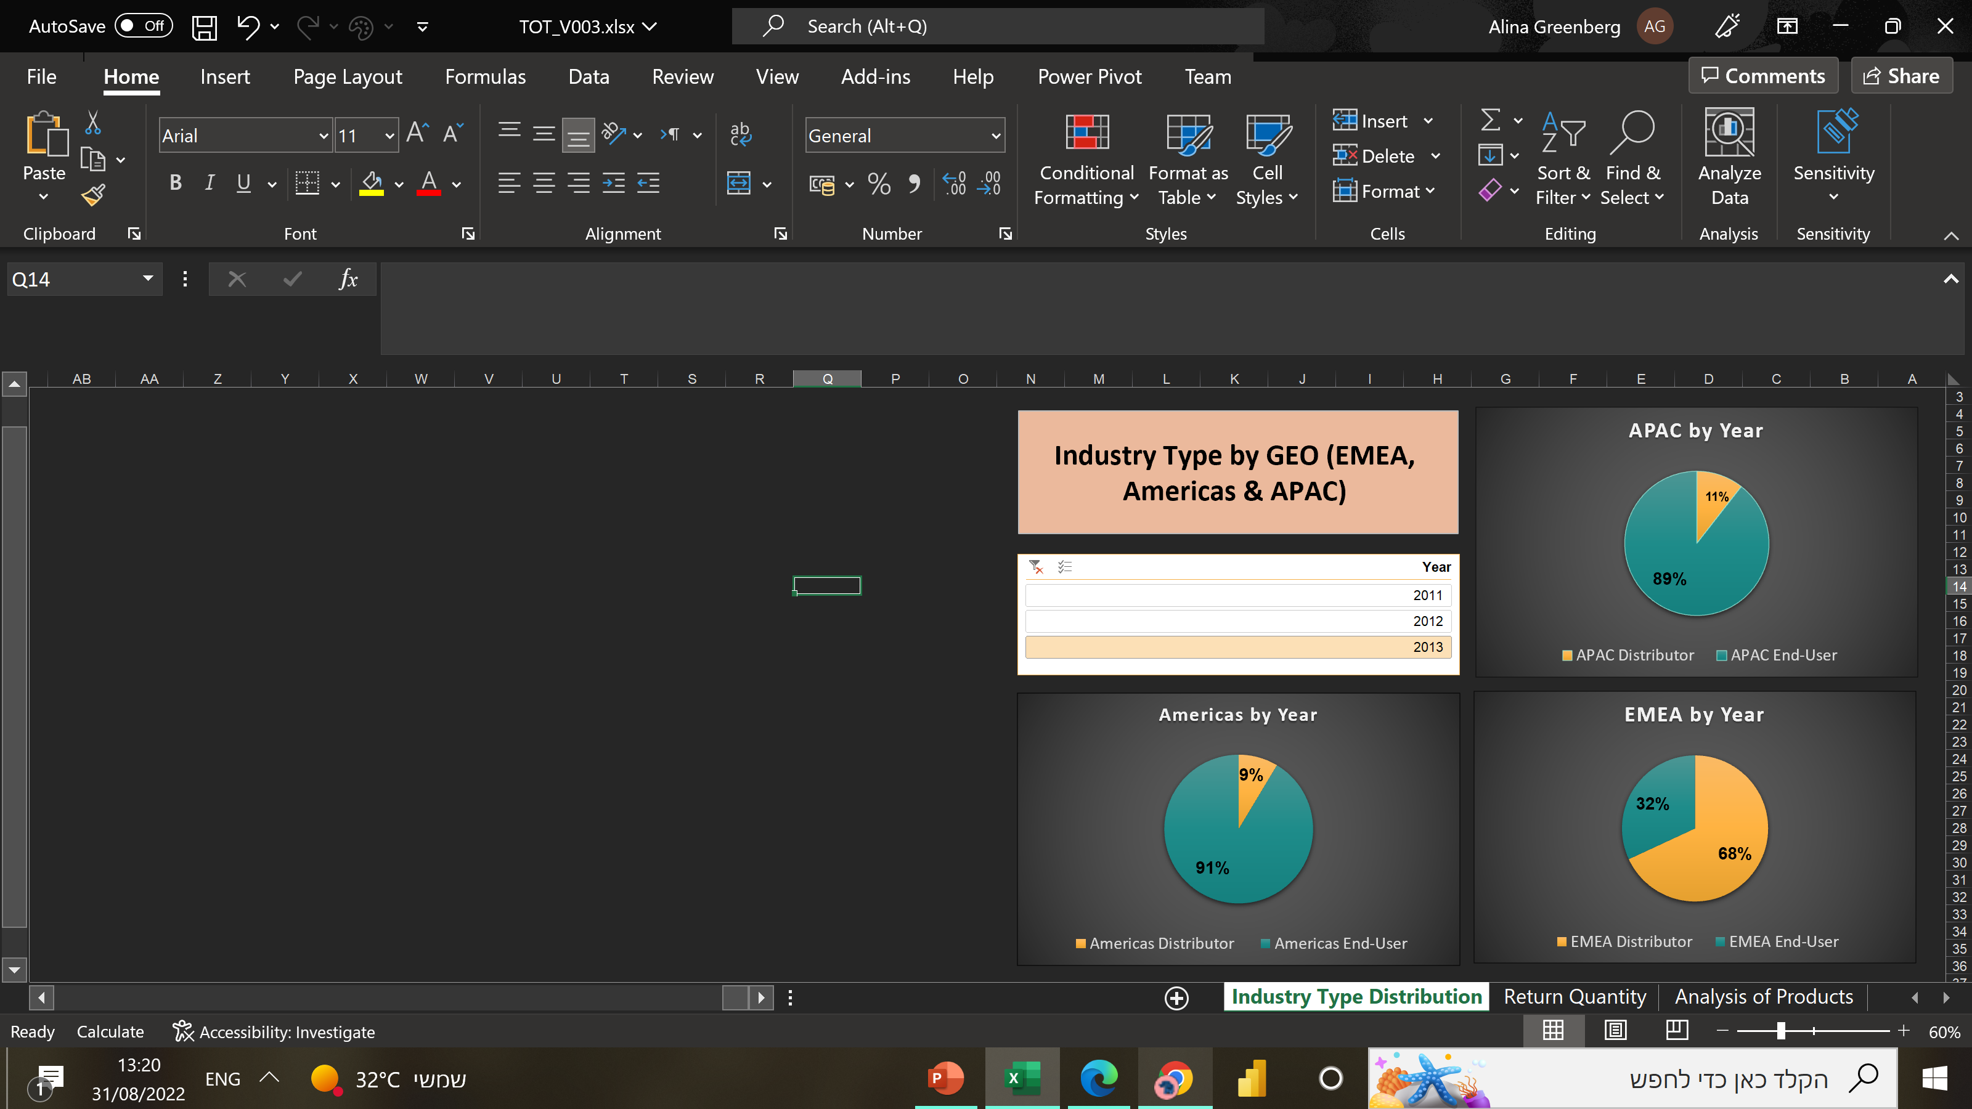
9

Slide 10
Observation for Industry Type by GEO:
APAC and Americas hold a very similar division structure, with End Users having an overwhelming participation of over 80%. The situation is absolutely reversed when analyzing EMEA, where 70% of customers are distributors. EMEA is a very diverse region involving Europe, the Middle East and Africa. It is possible that less developed economies with higher degrees of bureaucracy in the ME and Africa are more suitable for dealing with large distributors. If so, that is critical information that should be considered for strategic decisions within the company.
10

Slide 11
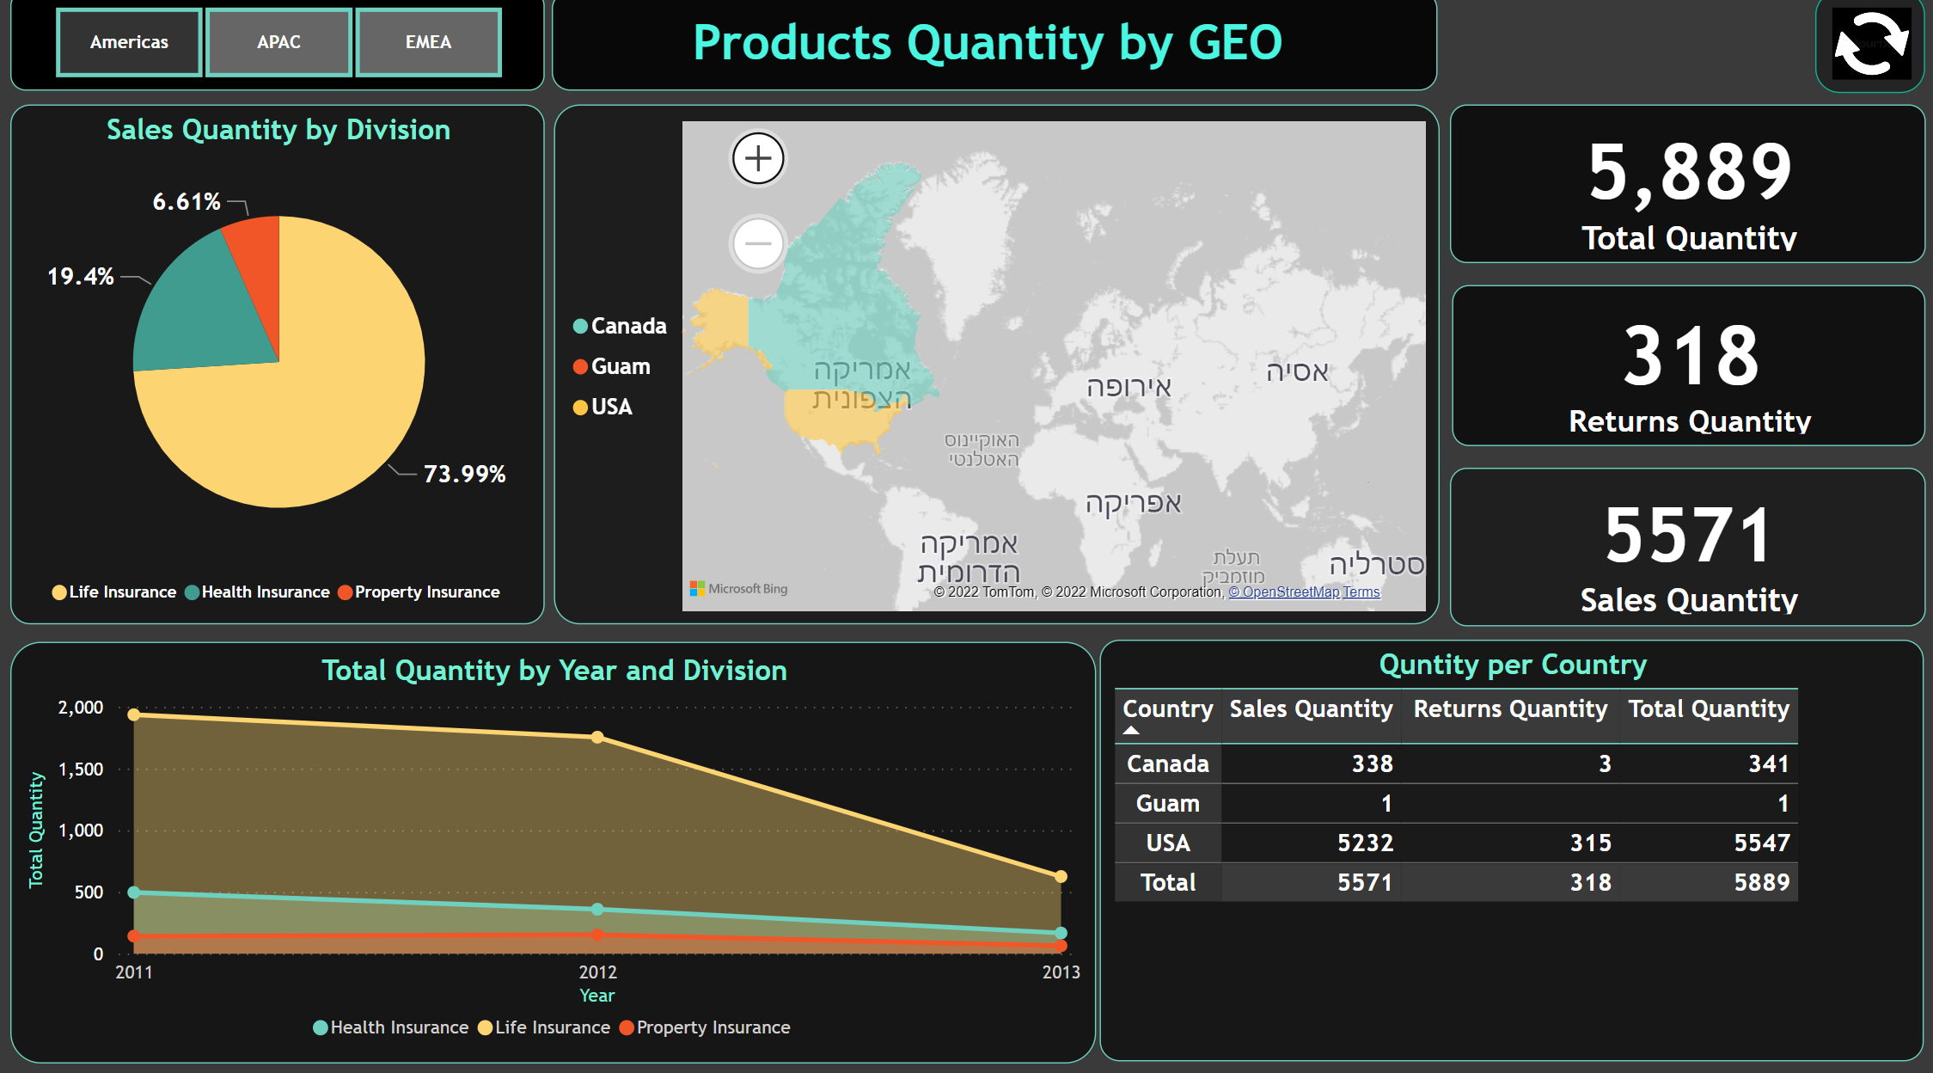
11

Slide 12
Observation for Products Quantity by GEO:
The order quantity remained somewhat stable throughout the years in both APAC and EMEA, but there was a consistent drop in Americas. This factor did not lead to a decrease in the total America’s revenue since it was compensated by an increase in the value per order. On any case, a sharp drop in quantity ordered is something to be looked into and monitored.
On all three regions Life Insurance takes the lead, closely followed by Health Insurance. Property insurance holds a miniscule relevance in the overall revenue composition of the company.
12

Slide 13
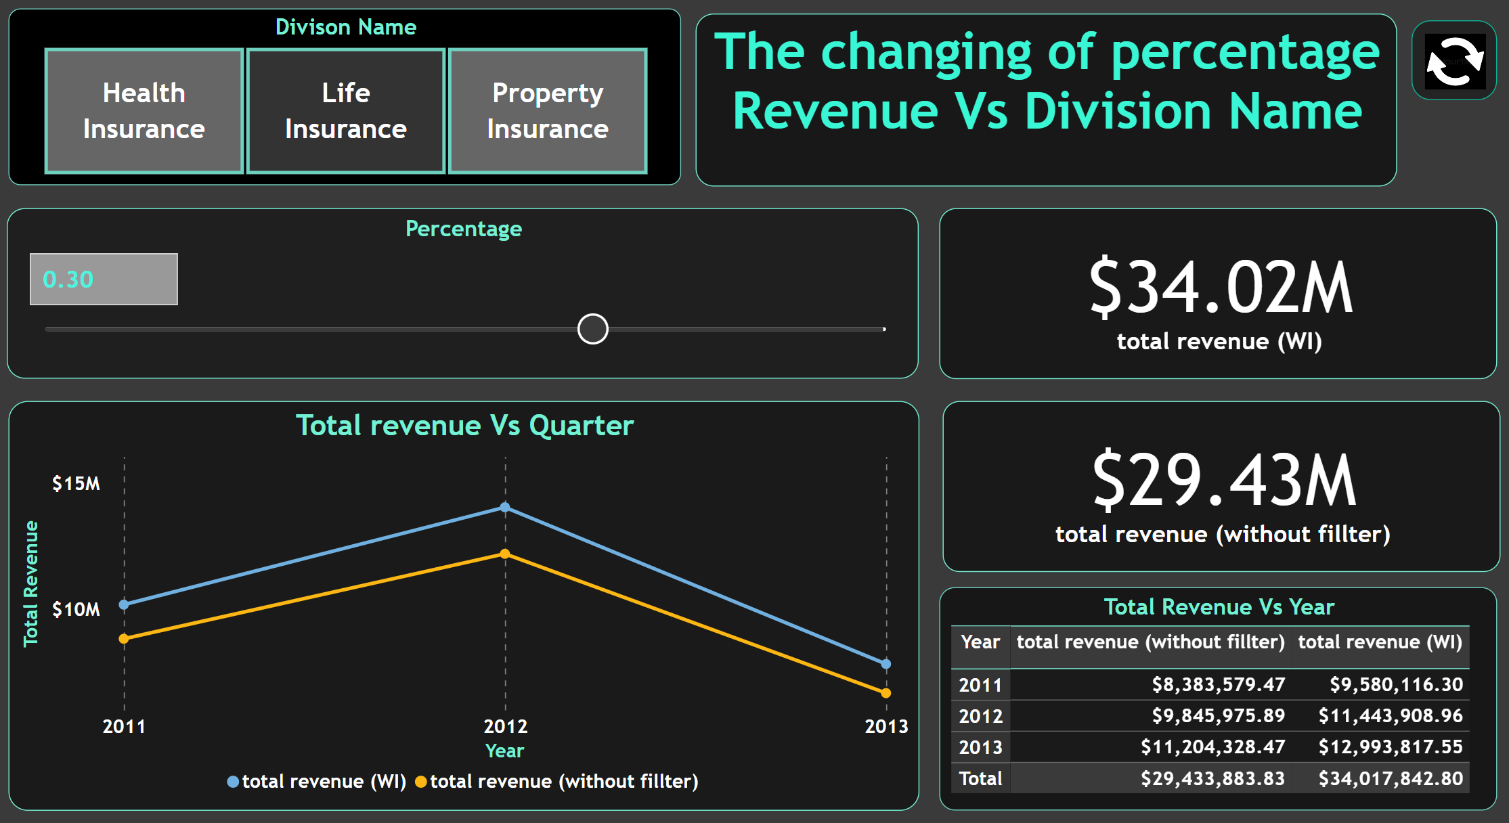
13

Slide 14
What would happen on the variation of Sales Revenue by Division Name:
Since Property Insurance does not hold a sizable portion of the overall revenue composition, even doubling its revenue would not create a noticeable variation on the performance of the company. To put it in perspective, it would be preferable to have Happy Insurance increasing 10% of its revenue in Health Insurance than increasing 100% of its revenue in Property Insurance.
14

Slide 15
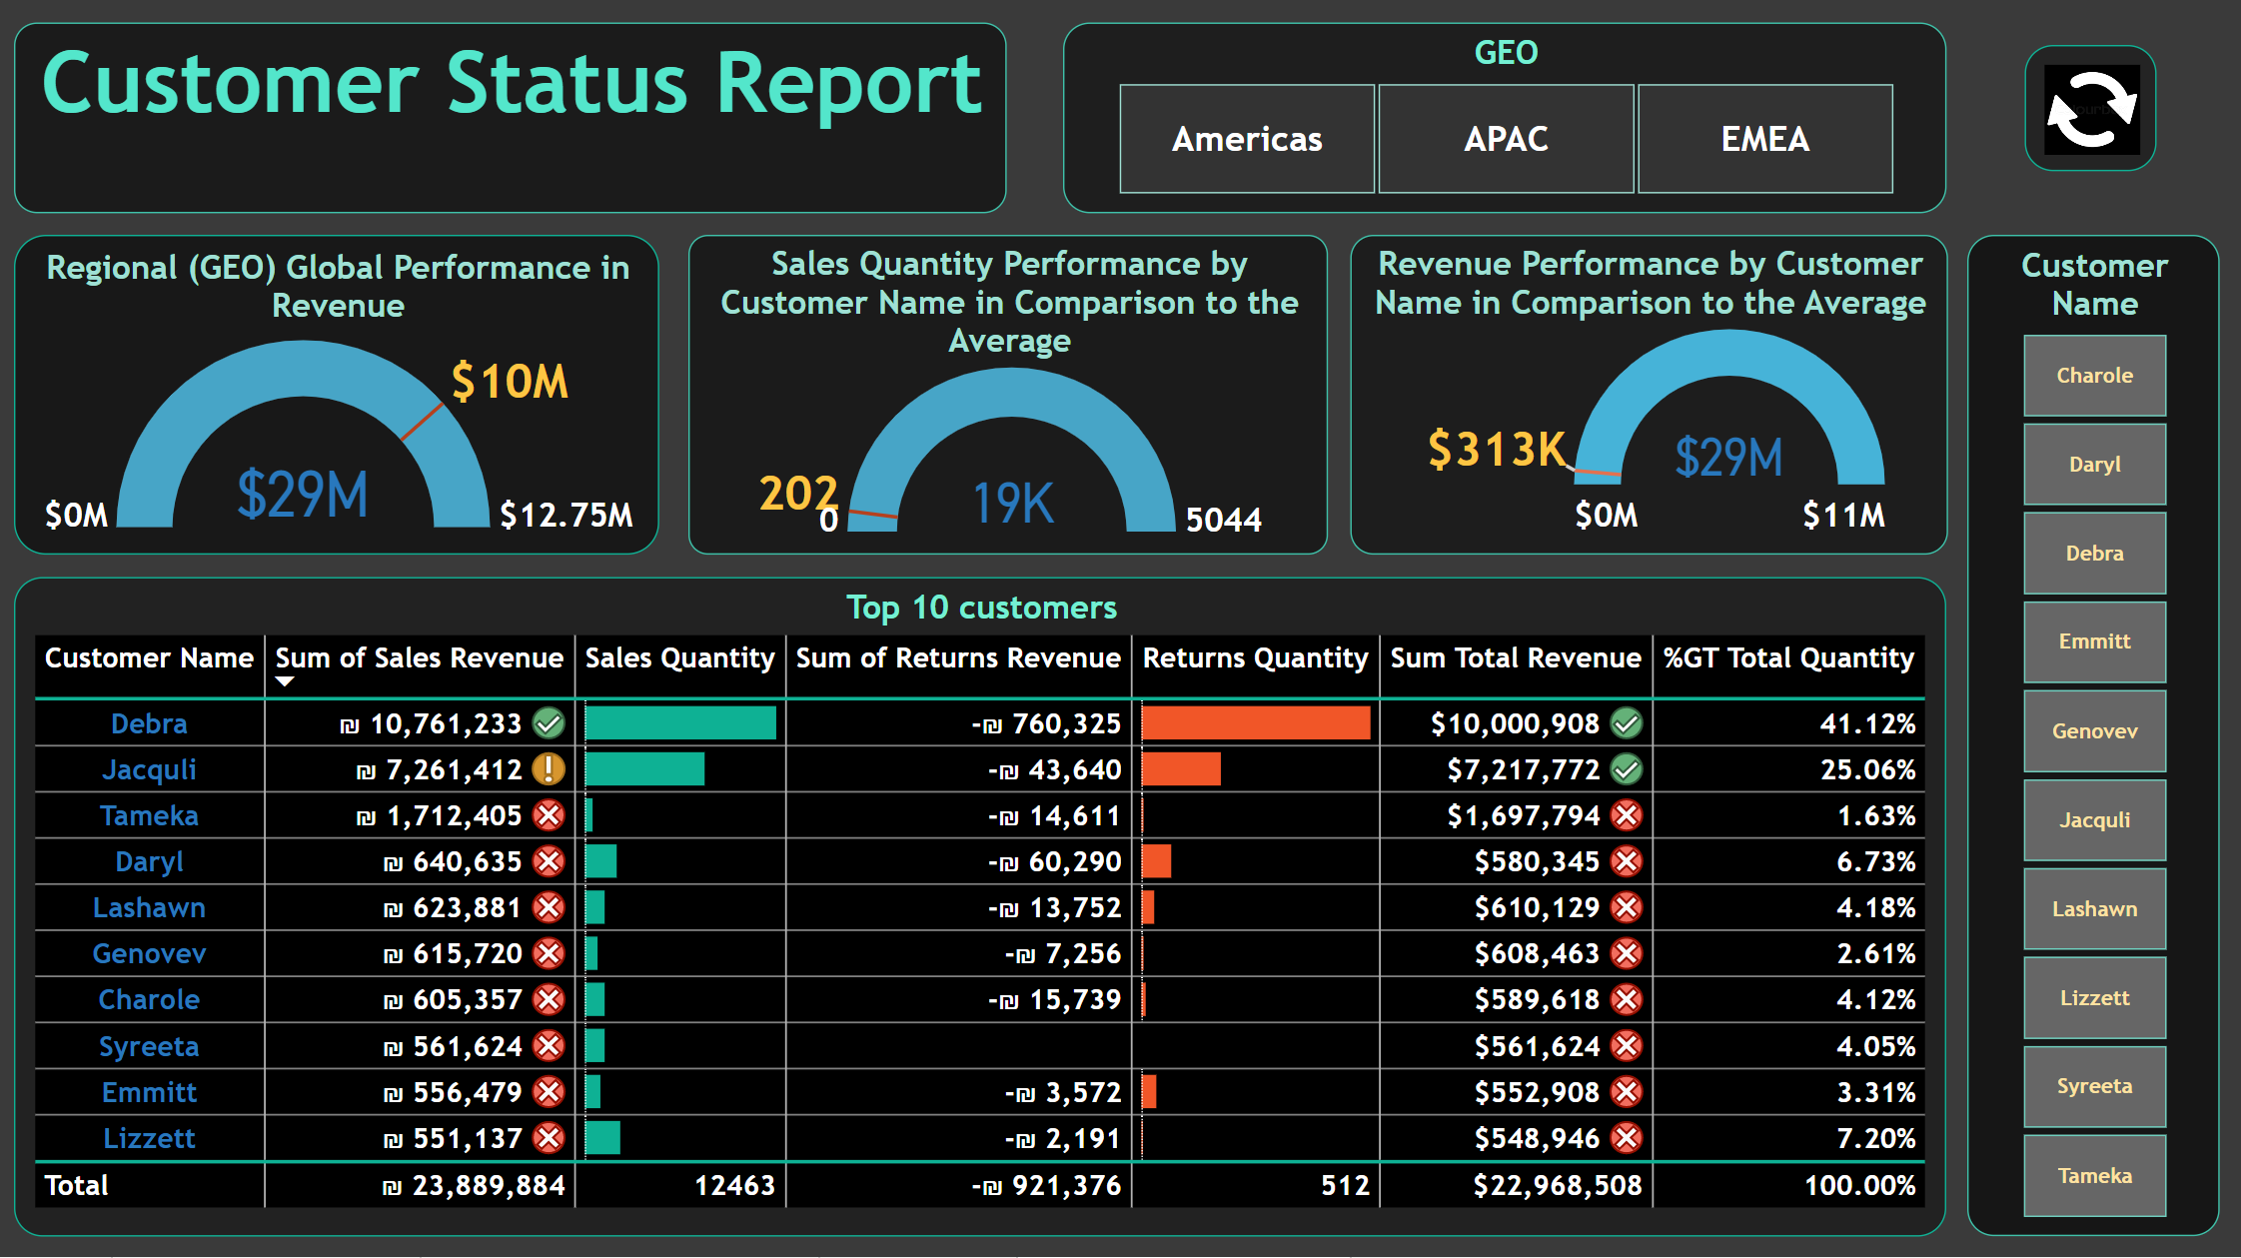
15

Slide 16
Customer Status Report:
When averaging the three GEO regions we see that EMEA is below the average line. This is reasonable since on its composition it includes African nations as well as Middle Eastern countries with low to middle income status, limiting the market purchasing power.
Regarding costumer names, we have a very concentrated distribution where the vast majority (over 80%) of the costumers find themselves below the average line and the top 3 customers are responsible for almost 70% of the total company revenue.
16

Slide 17



Conclusion
Although Happy Insurance ended 2013 with less quantity orders than in 2011, it still managed to have a higher revenue due to an increase in the value per order. While, on the surface the company seems financially healthy, it is highly dependable on its top 2 costumers, Debra (USA) and Jacquli (China) and this creates a strategic threat.
The Product Name Health 1 has been significantly losing sales participation to Heath 3 during the selected period. It would be important to further understand this phenomenon in order to have a better understanding of the market.
The disproportional return quantity in the Product Name Life 1 and Life 3 should be investigated in order to comprehend its origins.
Finally, it is recommended to no longer aggregate Europe, the Middle East and Africa into the same regional area since they are very heterogeneous and relevant information may be lost when combining such different realities.
17

Slide 18




Thank you

